Slide 1

PLACEMENT
BROCHURE
DEPARTMENT OF INFORMATION TECHNOLOGY
BATCH 2017
BACHELOR’S PROGRAMME IN
COMPUTER SCIENCE AND ENGINEERING
CSE
CENTRAL UNIVERSITY OF KASHMIR
KNOWLEDGE IS POWER
Contact: +919419505159, +919858715451 Email id : soetplacementcell@cukashmir.ac.in
Placement Brochure 2017 | 1

Slide 2
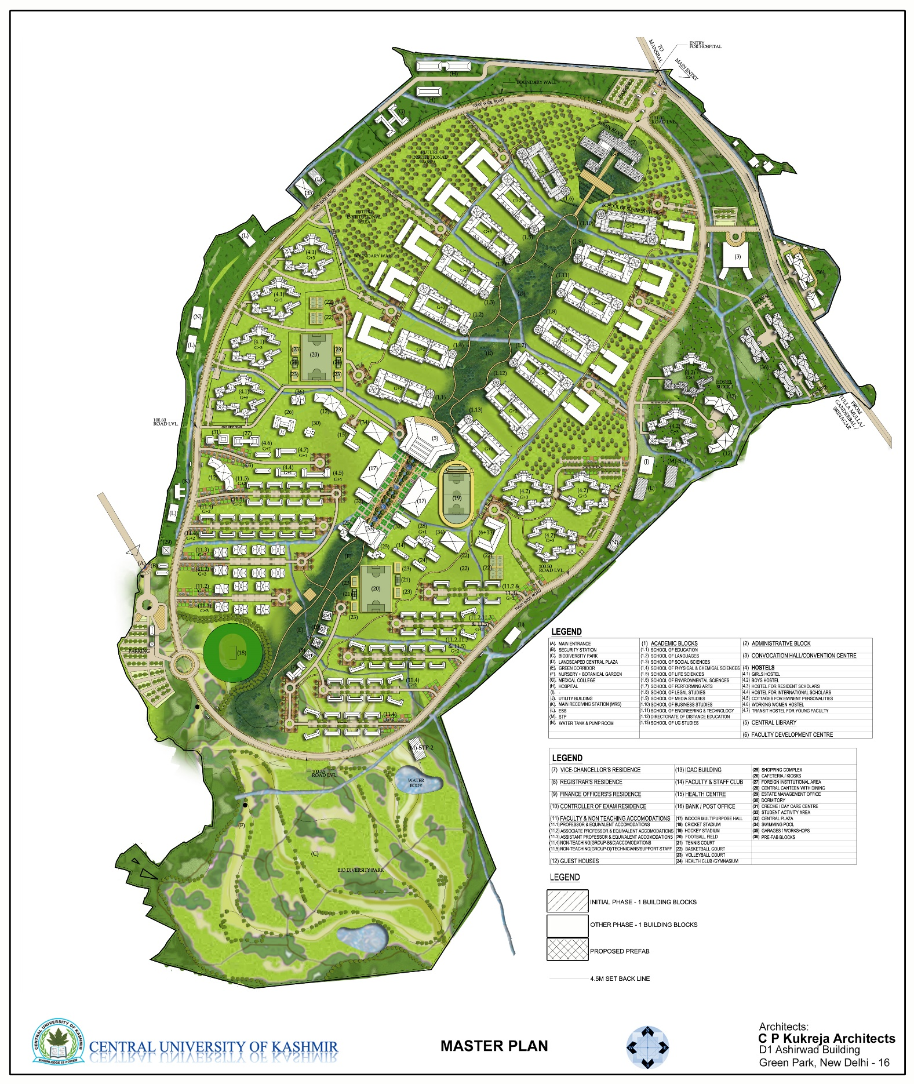
2| B.Tech CSE
Placement Brochure 2020 | 3

Slide 3
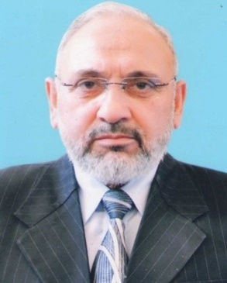
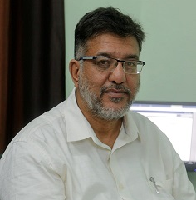
A warm welcome to all the organizations and their representatives who have chosen to engage with us to acquire talent for the bright future of our students as well as your organization.
I would like to reassure you that we have worked vigorously to ensure that our students acquire the knowledge, skills, competencies, behaviours, attitudes and values that are desirable to succeed both in professional space as well as personal space.
We have not just worked to create engineers for the future but also socially responsible citizens that will create value both in the field of Engineering and Technology as well as for the society that enables them.
We have worked collectively and tirelessly to make our students job-ready to ensure their smooth transition from Campus to Corporate. I am quite confident that our current and future students will follow the lead of our past Alumni that are working as Academicians, in MNC’s, government organisations or pursuing higher studies at top international institutes.
So, I welcome you once again to our esteemed institute and acquire the talent that will create a sustainable future.
Regards
Dr. Mohammad Ahsan Chishti
Dean, School of Engineering and Technology
Prof Mehraj ud din Mir
Vice Chancellor,
Central University of Kashmir
Prof. Mohammed Afzal Zargar
Registrar,
Central University of Kashmir
MESSAGE
FROM
a
THE HON’BLE VICE CHANCELLOR
MESSAGE
FROM
REGISTRAR
HEAD
4 | B.Tech CSE
Placement Brochure 2020 | 5

Slide 4
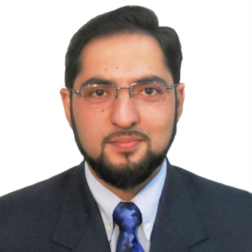
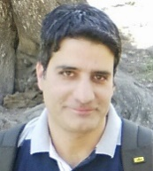
A warm welcome to all the organizations and their representatives who have chosen to engage with us to acquire talent for the bright future of our students as well as your organization.
I would like to reassure you that we have worked vigorously to ensure that our students acquire the knowledge, skills, competencies, behaviours, attitudes and values that are desirable to succeed both in professional space as well as personal space.
We have not just worked to create engineers for the future but also socially responsible citizens that will create value both in the field of Engineering and Technology as well as for the society that enables them.
We have worked collectively and tirelessly to make our students job-ready to ensure their smooth transition from Campus to Corporate. I am quite confident that our current and future students will follow the lead of our past Alumni that are working as Academicians, in MNC’s, government organizations or pursuing higher studies at top international institutes.
So, I welcome you once again to our esteemed institute and acquire the talent that will create a sustainable future.
Regards
Dr. Mohammad Ahsan Chishti
Dean, School of Engineering and Technology
Dr. Mohammad Ahsan Chishti
Dean,
School of Engineering &Technology
Afaq Alam Khan
Head/Coordinator,
Department of Information Technology
MESSAGE
FROM
MESSAGE
FROM
DEAN
HEAD/
COORDINATOR
HEAD
6 | B.Tech CSE
Placement Brochure 2020 | 7

Slide 5

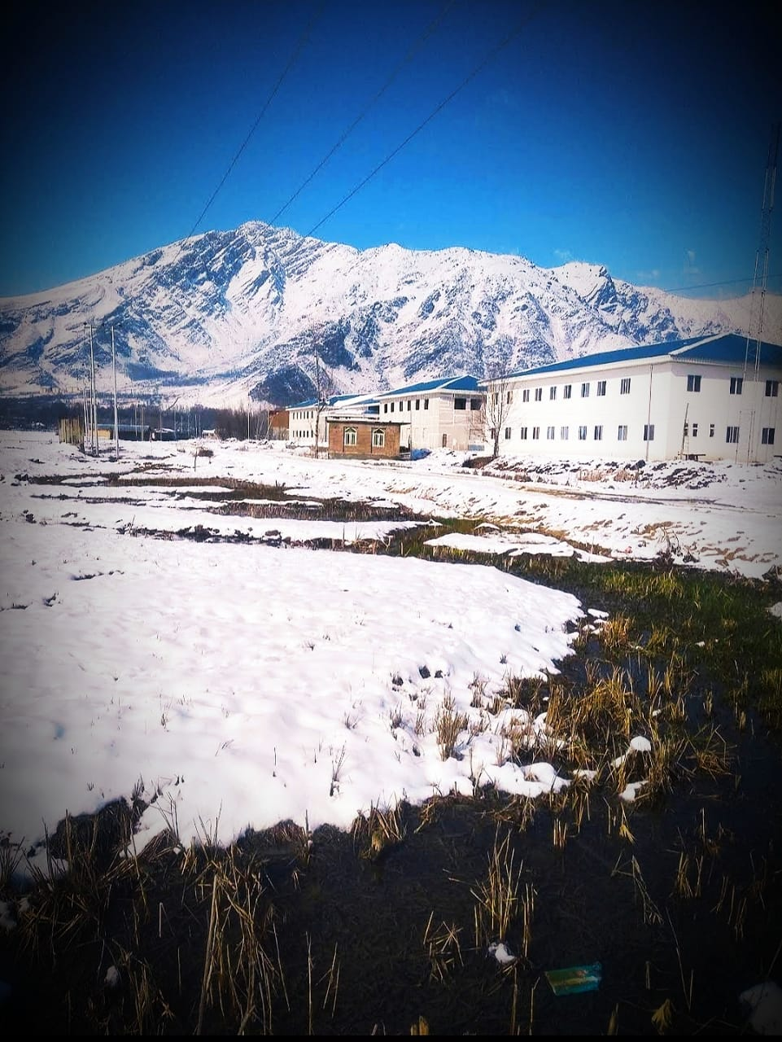

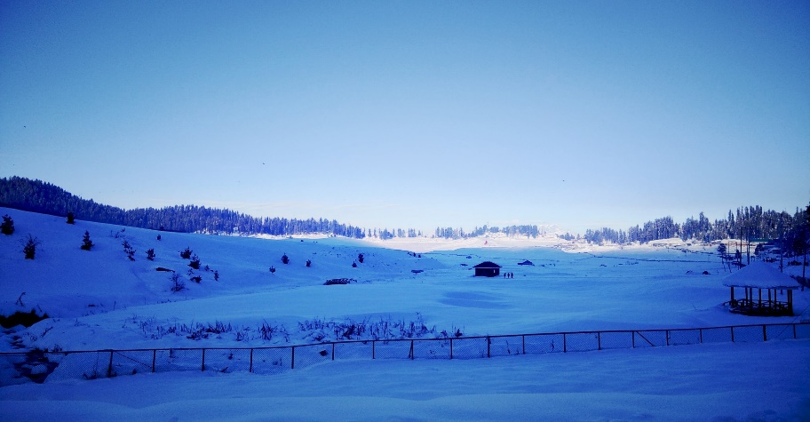
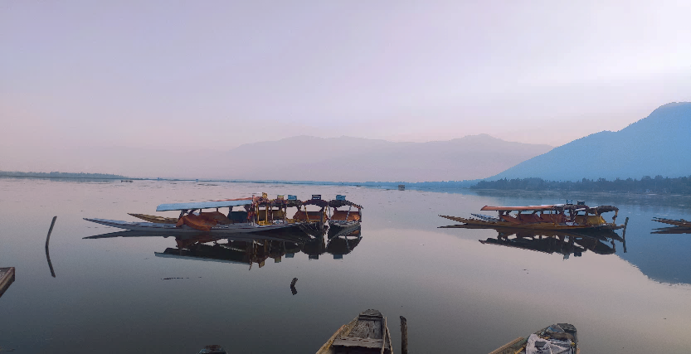
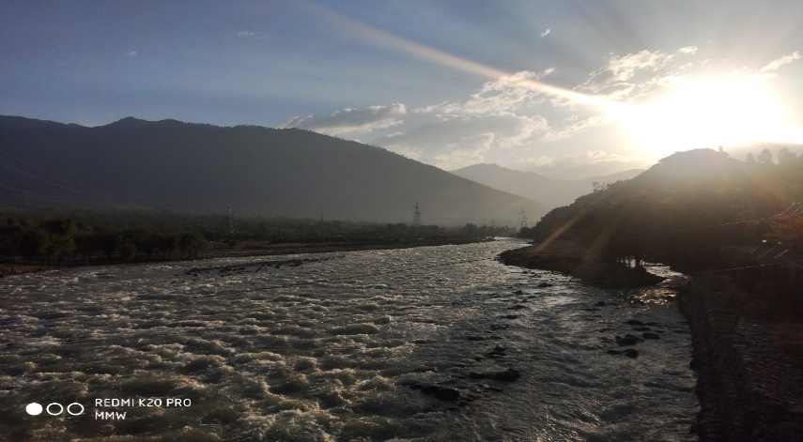
ABOUT
Central University of Kashmir
It is rightly said that by Jahangir one of the rulers of the Mughal era that, “if there is heaven on earth it is this, it is this, it is this ”.The Scenic & the screne beauty of this place called “Kashmir” can surely not be expressed in words. One who has been here can only know what it feels like to be in heaven on earth. People of Kashmir & KASHMIRIYAT are the things to look out for , here. People , tradition , the hospitality is what KASHMIRIYAT is all about. People & students from all over the world come here to see the culture & traditions that have been passed on since centuries. The People from not Kashmir but from far off places share their culture and tradition. The ambience of the diverse social background means mutual exposure which trains for global careers that have similarly challenging environment
Central University of Kashmir (formerly known as the Central University of Jammu and Kashmir) was established in March 2009 with the appointment and joining of Prof. Abdul Wahid Qureshi , a noted academician and the former Vice Chancellor of University of Kashmir, as the First Vice Chancellor.
Transit Campus of the University was setup at Sonwar in August, 2010.
It currently operates from four campuses: Green Campus. Administrative Campus at Duderhama, Nunar campus, Science Campus at Old Hospital, and Main Campus at Tulmulla .
The main campus is setup in the picturesque view of the Harmukh mountain, giving the students a peaceful, lively and a serene environment to achieve fineness in the fields they work in.
Students are offered 'A' Grade facilities of library, internet, cafeteria, health club, hostel and transport services and assured scholarship to all the admitted research scholars.
Campus is developed on the modern design with features of green campus and energy efficient buildings. Provision for future expansion and space economy are the integral components of the plan.
Campuses are well equipped with an Integrated Security/Surveillance System using latest technological tools like Smart Cards (biometric), Electronic Intrusion Detection Systems, CCTV etc.
Quality education is provided in the fields of : Engineering and Technology, Social Sciences , Business studies, Legal Studies, Media Studies, Physical chemical sciences , Life sciences, Education ,Languages.
8| B.Tech CSE
Placement Brochure 2020 | 9

Slide 6
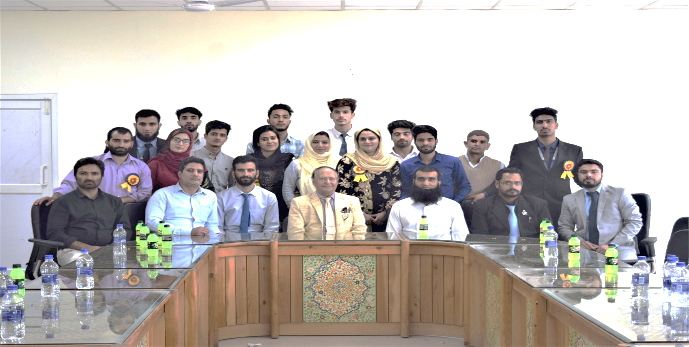
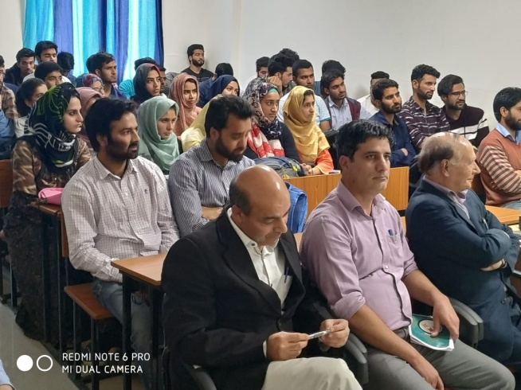
ABOUT
ABOUT
B.Tech CSE PROGRAMME
The Department is presently offering a B. Tech. in Computer Science & Engineering (CSE) which is a 4 year degree programme. Striving hard for excellence, the Department plans to diversify and expand its activities in the years to come .
The programme is aimed at fulfilling the ever increasing demand of trained computer science professionals in the industry. The students in this course receive rigorous training to face the challenges of today’s competitive world. The course is updated from time to time to keep up with the ever evolving IT sector. Emphasis is laid not only on the theoretical concepts but also on practical experience and industry interaction.
SCHOOL OF ENGINEERING & TECHNOLOGY
The Department of Information Technology is a flagship department under the School of Engineering and Technology. Having an up-to-date curriculum, well trained faculty and an excellent infrastructure, the Department is committed to develop highly skilled Information Technology (IT) professionals, capable of meeting the ever-changing and increasing needs of the IT industry. The faculty has a very good profile with a number of publications and patents. Presently existing only as a teaching department, the University has plans to make to it a teaching-cum-research department in near future.
The Department is presently offering a 2 year Post-Graduate programmed leading to the degree of M. Tech. in Information Technology in addition to B. Tech. in Computer Science & Engineering (CSE) which is a 4 year degree programme. Striving hard for excellence, the Department plans to diversify and expand its activities in the years to come.
The school of Engineering and Technology has the support of ITSS , well equipped labs for the same .
10| B.Tech CSE
Placement Brochure 2020 | 11

Slide 7
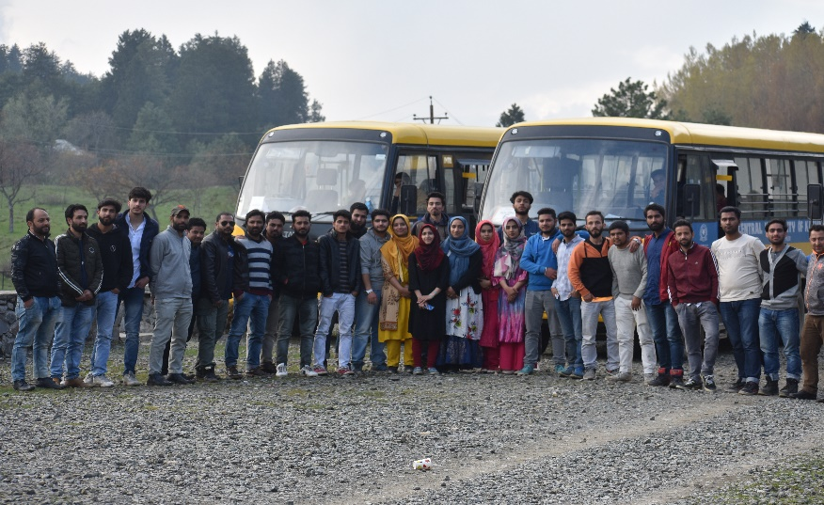
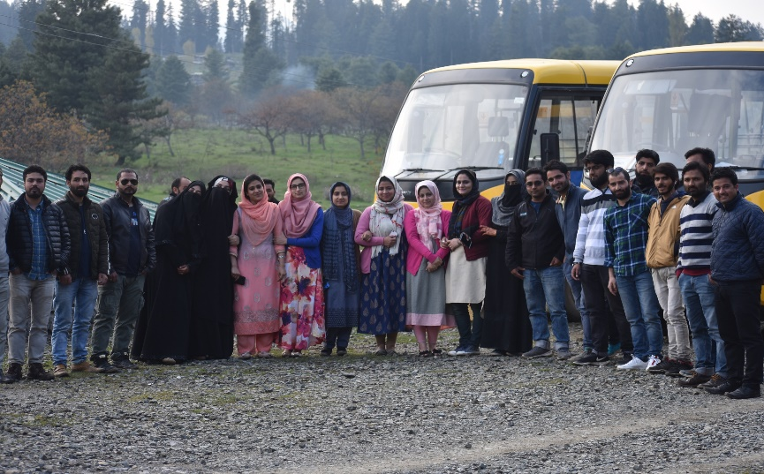
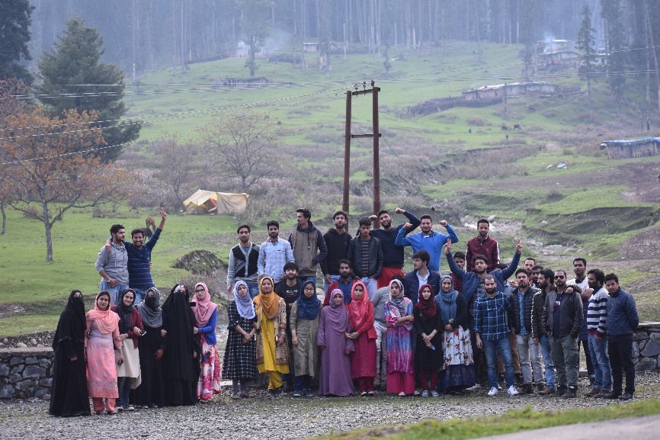
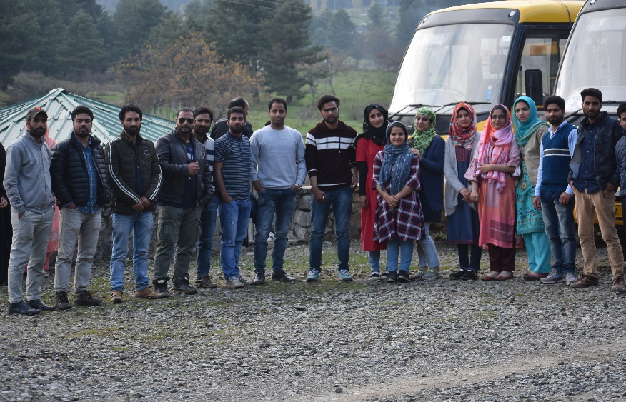
CURRICULUM
FIRST YEAR
C Programming ,Physics I, Physics II, Chemistry I, Chemistry II, Engineering Drawing, Engineering Workshop
Engineering Mathematics I, Engineering Mathematics II, Sociology ,Communication skills, Electrical ,
Engineering Mechanics, Electrical Lab, Physics Lab I, Physics Lab II , Chemistry Lab I , Chemistry Lab II ,
C programming Lab
.
SECOND YEAR
Data structure, Operating System, OOPS programming, Discrete mathematics, Engineering mathematics III, Digital logics,
Engineering mathematics IV, Basic Electronics, Environmental Studies, Economics for Engineers, Data Structure Lab , OOPS Lab, Electronics Lab, Logic Design Lab
THIRD YEAR
Java Programming, DBMS, System analysis and design, Computer organization and Architecture,
Computer Networking, Software Engineering, Design of algorithm, Theory of Computation, DBMS Lab , Java Lab,
Industrial Training, E-Commerce
COURSES OFFERED
SEMESTER IV
Complier Design, Microprocessor, Web Design and Technology, Microprocessor Lab, Seminar,
Web Design & Development Laboratory
M.Tech in Computer Science &Engineering
B.Tech in Computer Science &Engineering
12 | B.Tech
Placement Brochure 2017 |13

Slide 8
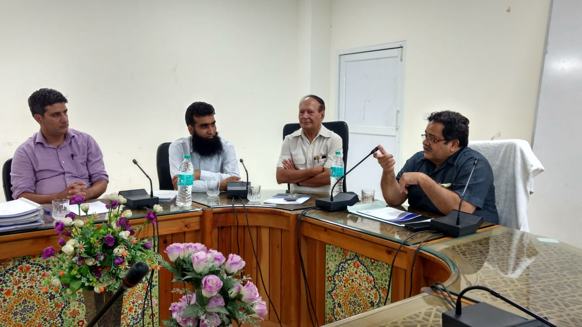
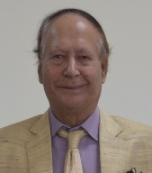
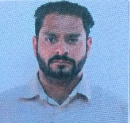

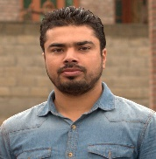
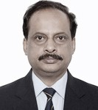
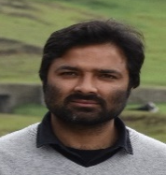

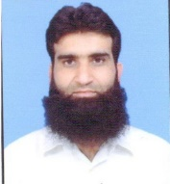
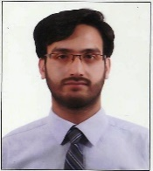
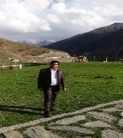
THE
FACULTY
Er. Mir Aman Sheheryar
Assistant Professor, Dept. of IT [M.Tech, Sharda University ]
Prof.A.M.Wani
Professor, Dept. of IT
[PhD, IIT Delhi]
Dr. Ahsan Chishti
Dean,
School of Engineering & Technology
Associate Professor, Dept. of IT
[PhD, NIT Srinagar]
Er. Sheikh Riyaz
Assistant Professor, Dept. of IT [M.Tech, Jamia Hamdard ]
Er. Afaq Alam Khan
Head/Coordinator ,
Dept. of IT
Assistant Professor, Dept. of IT
[M.Tech, TMU, Tehran, Iran]
Er. Amjid Hussain
Assistant Professor, Dept. of IT
[M.Tech, IIIT Bhubaneswar ]
Er. Abiroo Badar
Teaching Assistant , Dept. of IT
[M.Tech, Central University of Kashmir]
Er. Zahoor Ahmad Najar
Director Campus CUK Tulmulla
Assistant Professor, Dept. of IT
[M.Tech, NIT Srinagar]
[Pursuing PhD, NIT Srinagar]
Rizwana Rashid
Teaching Assistant , Dept. of IT [M.Sc., Central University of Kashmir]
Er. Sheikh Nasrullah
Assistant Professor, Dept. of IT
[PhD, Italy.]
Mr. Abdul Mohsin Bhat
Teaching Assistant, Dept. of IT
[M.Sc., Central University of Kashmir]
Er.Yash Paul
Assistant Professor, Dept. of IT
[M.Tech]
[Pursuing PhD, Hungary]
14| B.Tech CSE
Placement Brochure 2020 | 15

Slide 9
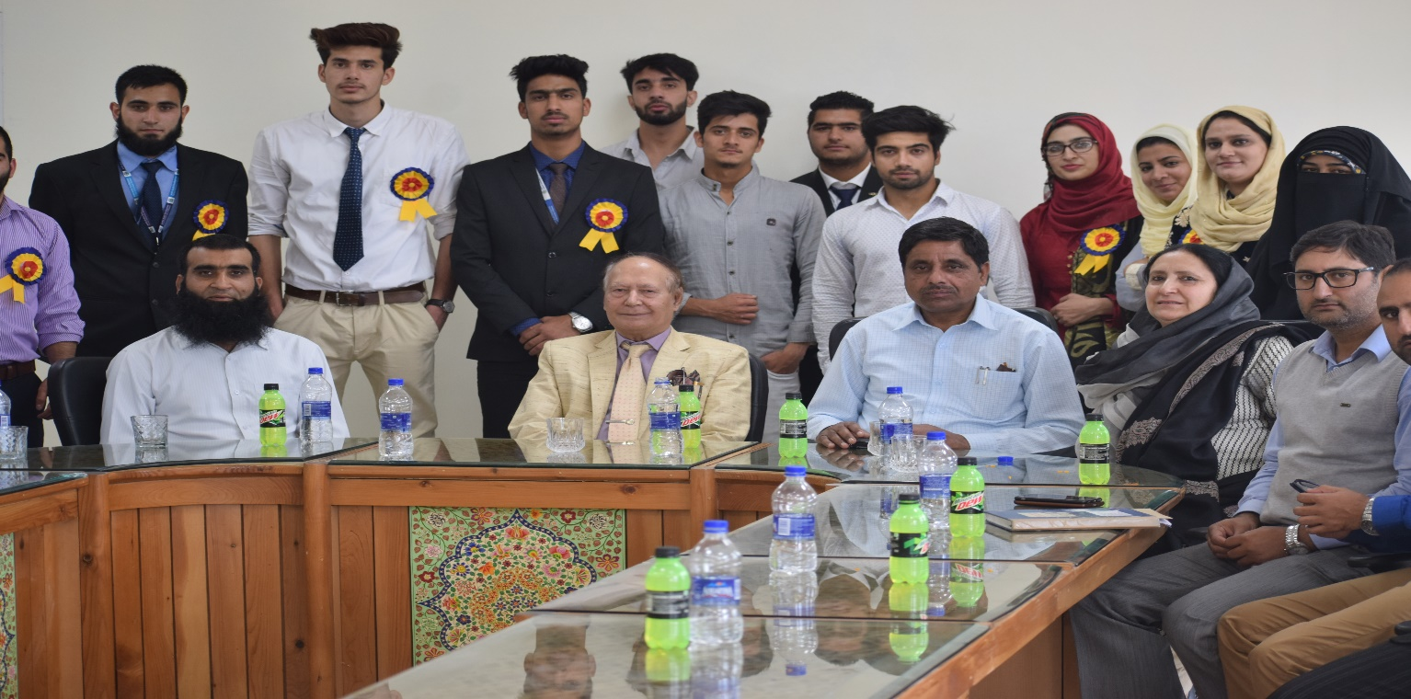
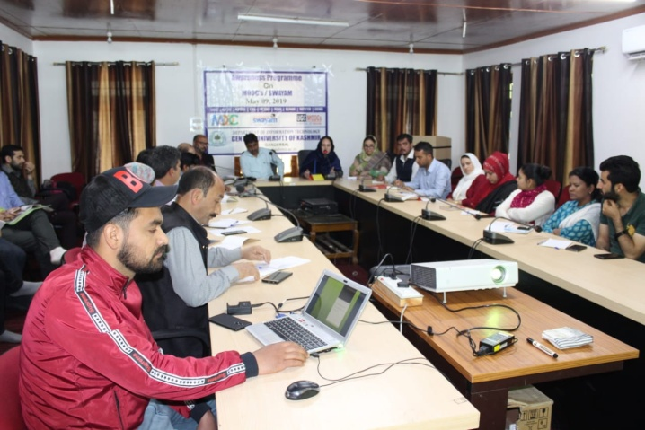
EVENTS
Extension Lecture on "IT Job Prospects" by Mr. Mr. Payam Irani, Sr. Oracle e Business suit Analyst working in "Image Communication", Toronto, Canada on 4/5/2016
Department of IT Organized awareness programme on “MOOCs/ SWAYAM” on 9/5/2019. Dr. Heena Basharat, Assistant Professor Department of Law, UoK and Mr. Tariq Abdullah, Producer EMMRC, University of Kashmir were the resources persons. Representatives from all the Departments and various sections of the University participated in the event.
An expert Lectures on "Nano Technology & Nano Robotics” by Dr. Rajiv Kumar (Scientist at DRDO, International Advisor Scientist Elsevier USA and former faculty at Delhi University) and Prof. A. M Shah ( Professor in the Department of Physics, NIT- Srinagar, was held in the Department of Information Technology on 23/5/2019.
Organized Webinar “Artificial Intelligence, ML & VR”, in collaboration with Sofcon India Pvt Ltd. Delhi on 23rd June, 2020 for the students and faculty members of the Department
Director IIT Kharagpur Prof. P. P. Chakarborty, interacted with the students and faculty members of the Department of Information Technology on 9/5/2016 at Nowgam Campus of CUK. In his address Prof. P. P. Chakarborty talked about different projects that are being perused at IIT khargpur which include Signal & System in life Science, Future of Cities, Science & Heritage, Food Security, GIAN and National Digital Library etc.
PRAVESH EVENT
Students of the Department of Information Technology organized the “Prayesh” fest on the
eve of shifting of the Department to Tulmulla Campus.
Expert Lecture delivered by Er. Ashiq Hussain, Joint Director, NIELIT on “Issues in Networks” for the students of M. Tech. IT on 10/10/2017
Expert Lecture delivered by Dr. Asif Assad, faculty at IUST on “Genetic Algorithm” on 7/3/2018
Department of Information Technology in Collaboration with JKEDI Organized one Day Awareness Programme on Entrepreneurship for the students of M.Tech. IT and B.Tech. CSE on 11/4/2018
Extension Lecture by Dr. M. J. Zarabi, Chairman Board of Governors, NIT, Srinagar and chairman Masamb Electronic Systems- Noida on 7/10/2015.
Organized two Webinars on “Education & Higher Purpose” and “From Dissention to Elation at Work” on 27/7/2020 and 12/8/2020 respectively. Lectures were delivered by Dr. Tasaduq H. Mir, M.D UT Southwestern Medical Center, Dallas, Taxas, USA
16 | B.Tech CSE
Placement Brochure 2020 | 17

Slide 10
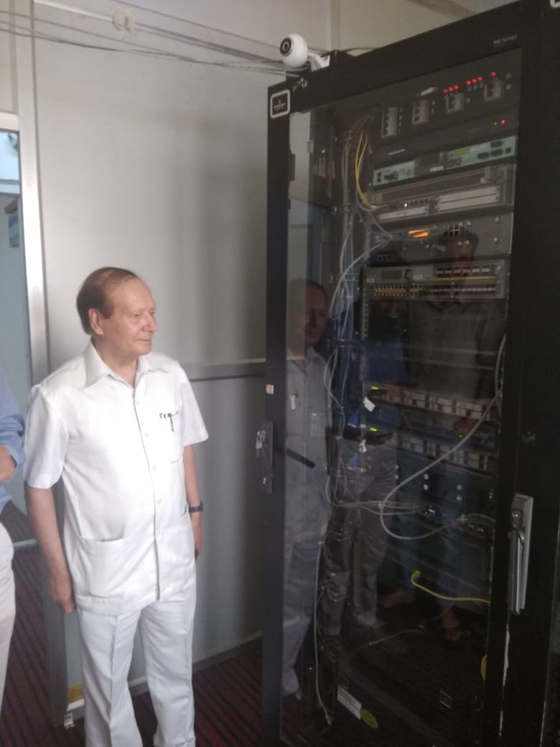
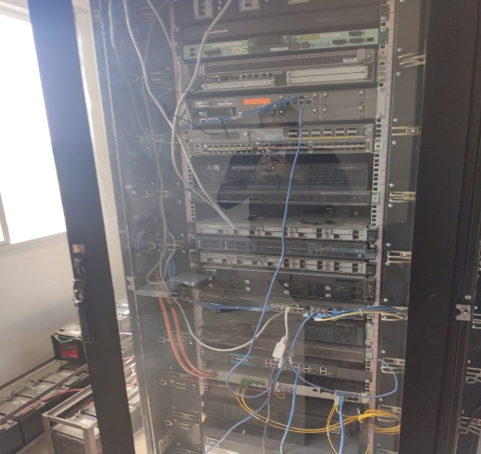
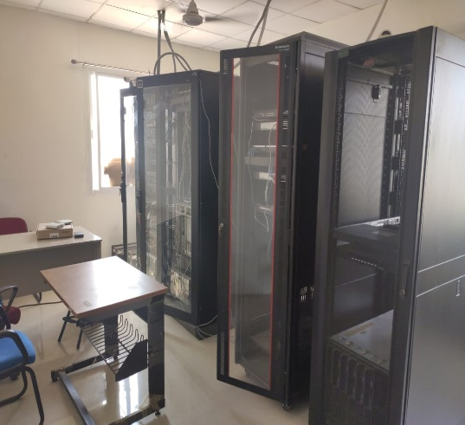
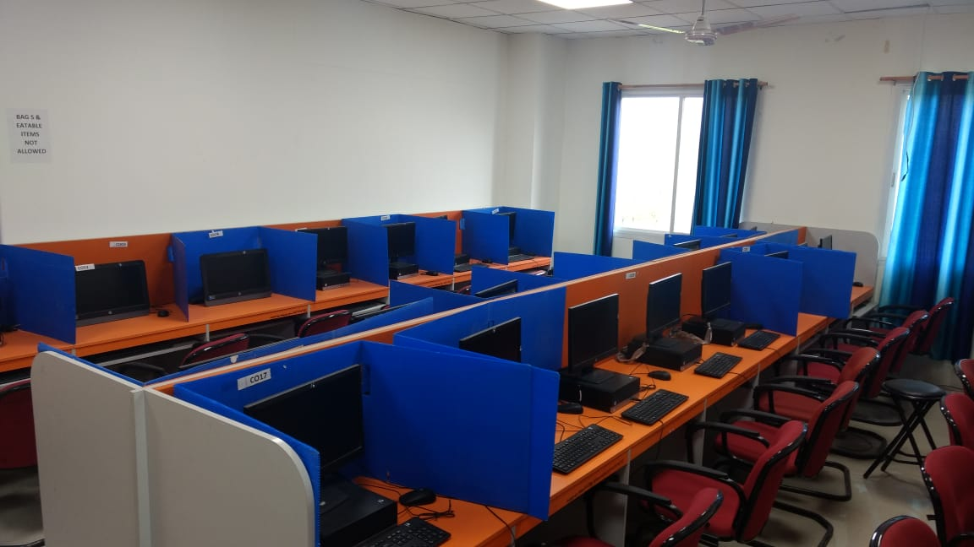
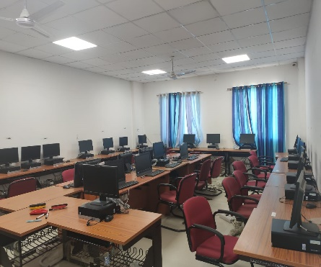
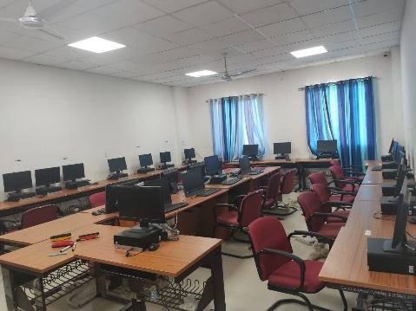
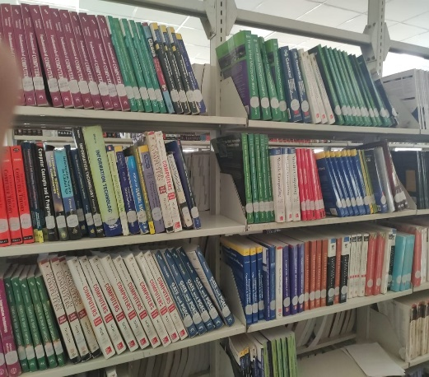
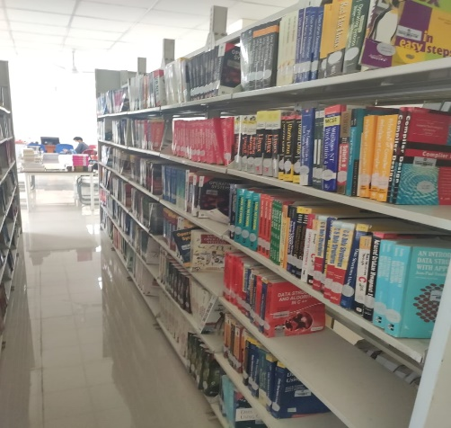
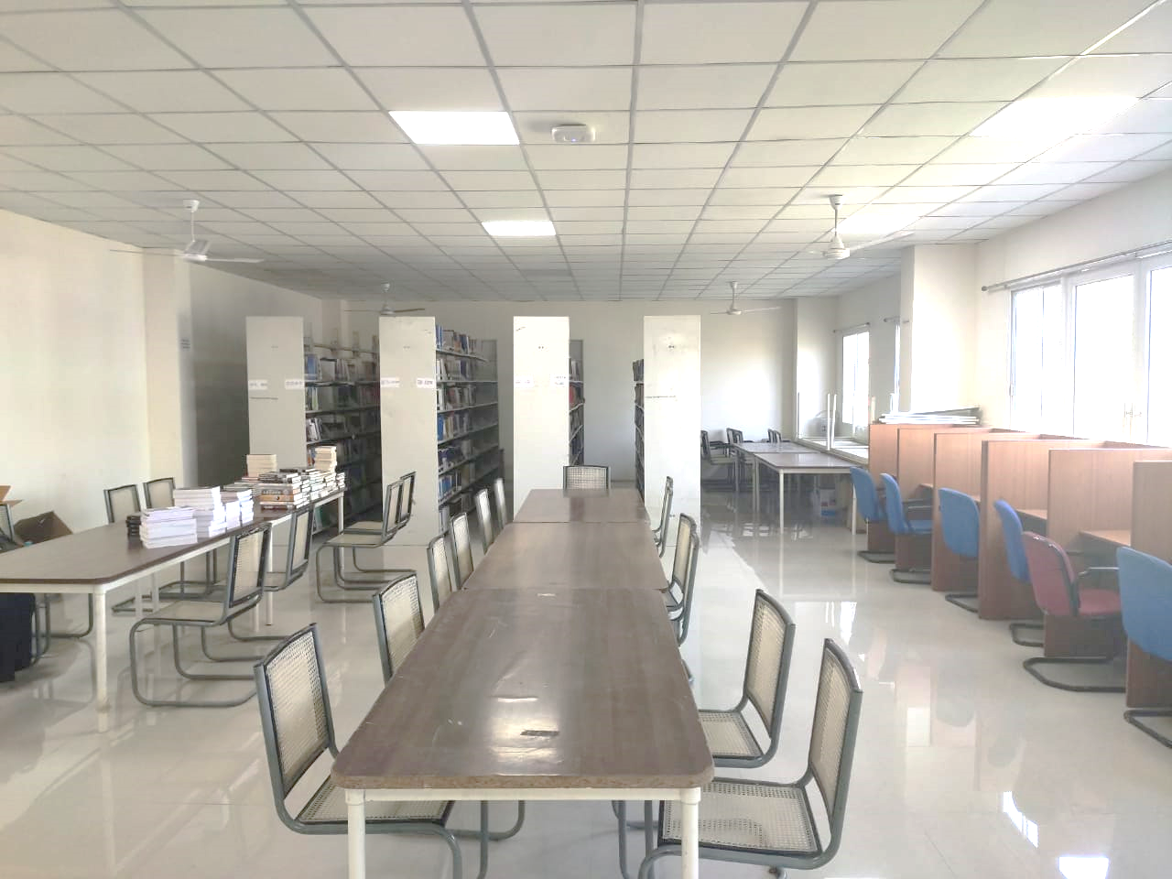
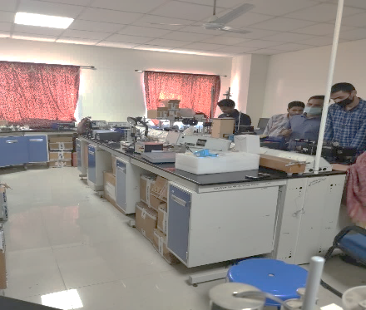
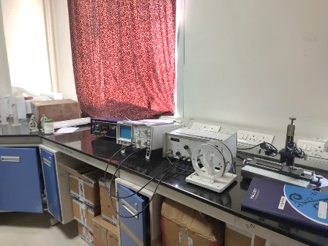
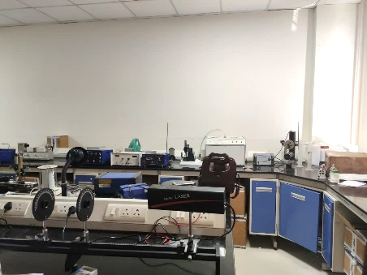
RESOURCES
COMPUTER LAB
STATE OF ART DATA CENTER LABORATORY
LIBRARY
PHYSICS LAB
18 | B.Tech CSE
Placement Brochure 2020 | 19

Slide 11

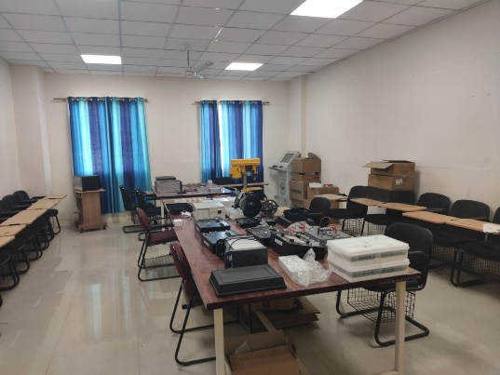
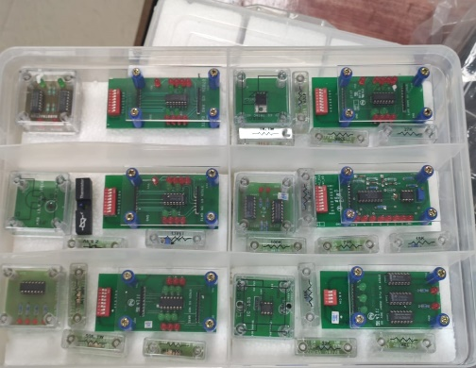
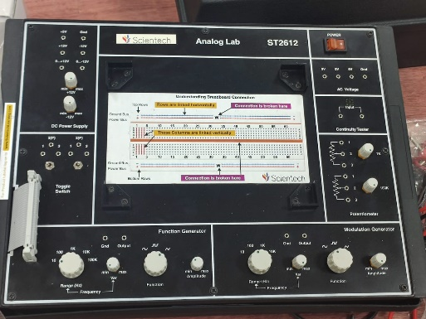
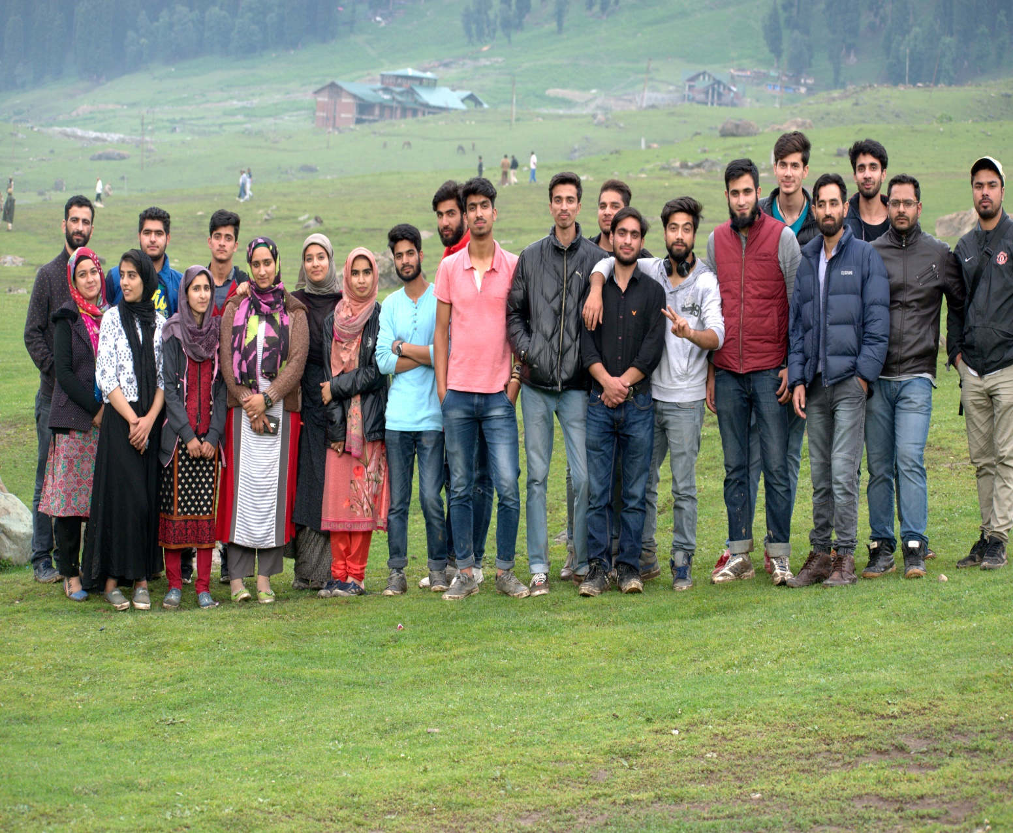
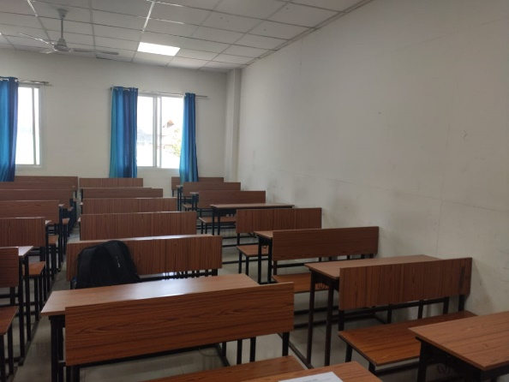
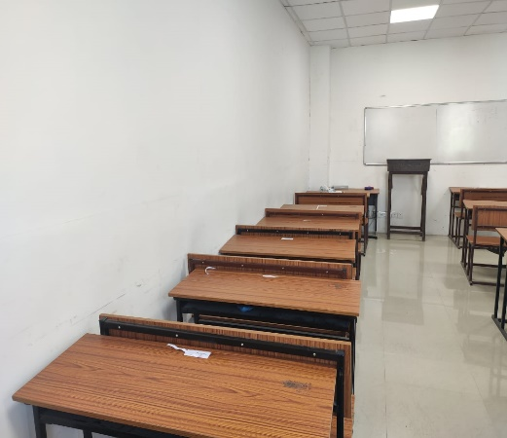
ELECTRONICS LAB
CLASS PROFILE BATCH 2017
GENDER DIVERSITY
CLASSROOMS
20 | B.Tech CSE
Placement Brochure 2020 | 21

Slide 12
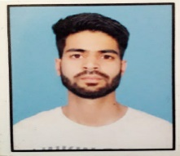
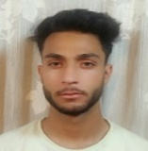
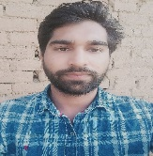
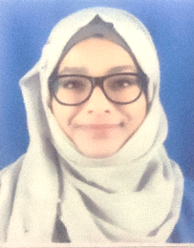
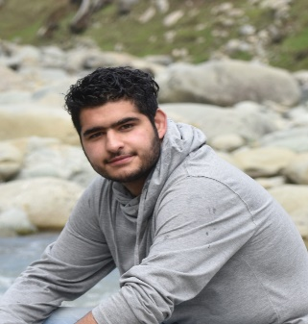
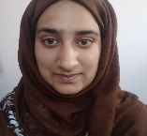





















STUDENT
PROFILES
AADIL BASHIR
Phone Number: +917006317445
Email id :aadilbashir333@gmail.com
FAYEZ ALI
Phone number: +917006777657
Email id : fayizalimir111@gmail.com
MUJEEB FAROOQ
Phone number: +919797939565
Email id :wagaymujeeb@gmail.com
SHAMIKHA ALI
Phone number: +919622562497
Email id : shamikha2871998@gmail.com
HEEMAH HUSSAIN
Phone number: +919596502820
Email id :hemahhussain292@gmail.com
NOMAAN AHMED QADRI
Phone Number: +919797112660
Email id: nomaanahmad77@gmail.com
SHEIKH MOHAMMAD ADNAN
Phone number: +917006080684
Email id :shiekhadnan.ad@gmail.com
AATIF ALI BEIGH
Phone Number:+917006221062
Email id :aatifali.beigh@gmail.com
OVAIS IQBAL SHAH
Phone number: +917889750770
Email id :dk90910@gmail.com
UMER FAROOQ KHAN
Phone number: +917006624359
Email id :khanumerkhan007@gmail.com
IMAD YASIN
Phone number:+919149826358
Email id :imadyasin07@gmail.com
AMINA ALI
Phone Number:+917006603071
Email id: eramina78@gmail.com
MALIK SHAHROOM
Phone number: +917006477002
Email id :malikkshahroom786@gmail.com
SHABNAM BASHIR
Phone number: +917889305972
Email id :shabnambashir37@gmail.com
YOUNIS RASHEED
Phone number: +917780908687
Email id :younisr89@gmail.com
AREEBA PARVEZ
Phone Number: +917006690343
Email id:areebawani222@gmail.com
SHAH MURTAZA
Phone number: +917051653704
Email id : shahmurtaza317@gmail.com
IQRAM UZ ZAMAN
Phone number: +919682343454
Email id :syediqram82@gmail.com
MANSHA ASHRAF
Phone number:+919149755006
Email id :daffanwani@gmail.com
ASIF AHMAD DAR
Phone number:+919086811422
Email id :darasi.cse@gmail.com
SHAHID MEHRAJ
Phone number: +917006350894
Email id :Shahidshah9622@gmail.com
MOHAMMAD MOAZUM WANI
Phone Number:+919858715451
Email id : moazumwani21@gmail.com
SHOWKAT AHMAD
Phone number: +916005927438
Email id :shyxum96@gmail.com
AYMAN MATTOO
Phone number: +918899946570
Email id :aymanmohiudin@gmail.com
SHAHID RASHID
Phone number: +917889962071
Email id: rathershahidrashid@gmail.com
MOHAMMAD BAQIR AMINEE
Phone number: +919549453610
Email id :mohdbaqiraminee51@gmail.com
BURHAN RASHID BHAT
Phone number: +917889977565
Email id :burhanbhatcuk@gmail.com
22 | B.Tech CSE
Placement Brochure 2020 | 23

Slide 13















ACADEMIC
Activities
Electrical Lab 2018
Engineering Workshop 2018
24 | B.Tech CSE
Placement Brochure 2020 | 25

Slide 14























CO-CURRICULAR
ACTIVITY
CONTACT US
Plantation Day 2020
Inter dept. cricket match IT vs physics
IUST Tech Fest 2012
Placement Coordinators
Aatif Ali Beigh
|+917006221062|
aatifali.beigh@gmail.com
Mohammad Moazum Wani |+919858715451| moazumwani21@gmail.com
Nomaan Ahmed Qadri
|+919797112660|
nomaanahmad77@gmail.com
Shamikha Ali
| +91 9622562497|
Shamikha2871998@gmail.com
Pravesh Event 2019
Final Inter dept. cricket between B.Tech IV sem and physical education
ISRO Visit
Class Picnic 2018 Sonmarg
Class Picnic 2019 Yousmarg
Boot Camp 2018
26 | B.Tech CSE
Placement Brochure 2020 | 27

Slide 15





HOW TO REACH US
FROM MAJOR METROPOLITAN CITIES
From Indira Gandhi International Airport
New Delhi
Kolkata Airport
From Srinagar International Airport
From Bangalore Airport
From Chandigarh Airport
28 | B.Tech CSE
Placement Brochure 2020 | 29

Slide 16

CONTACT US
Department of Information Technology
Central University Of Kashmir Tulmulla campus Ganderbal India
soetplacementcell@cukashmir.ac.in
Faculty In-charge
Er. Zahoor Ahmad Najar |+919419505159| zahoornajar@cukashmir.ac.in
Made by :Aatif Ali Beigh , Mohammad Moazum Wani , Shamikha Ali
Placement Coordinators
Aatif Ali Beigh
|+917006221062|
aatifali.beigh@gmail.com
Mohammad Moazum Wani |+919858715451| moazumwani21@gmail.com
Nomaan Ahmed Qadri
|+919797112660|
nomaanahmad77@gmail.com
Shamikha Ali |
|+91 9622562497|
Shamikha2871998@gmail.com
30 | B.Tech CSE

